Slide 1
Big Data Architectures
Big Data
Avlonitis Ektor – 216882
Lazarevic Milos – 272036

Slide 2
Project Components
Network
Applications
Network of financial and investment services of stock exchanges and investors
Applications that analyze these data

Slide 3
Network
Two Stock Exchange servers
Three Institutional Investors
Two Servers
Kafka topic “StockExchange”
Three Investors
Kafka topic “portfolios”
Twelve stocks each
Exclude weekends and Greek holidays
Daily fluctuation in stock price
Read from “StockExchange”
Three investors → Two portfolios each
Calculate: Evaluation, Difference, Percentage Difference
Emit JSON objects to Kafka topic
Emit JSON objects to Kafka topic

Slide 4
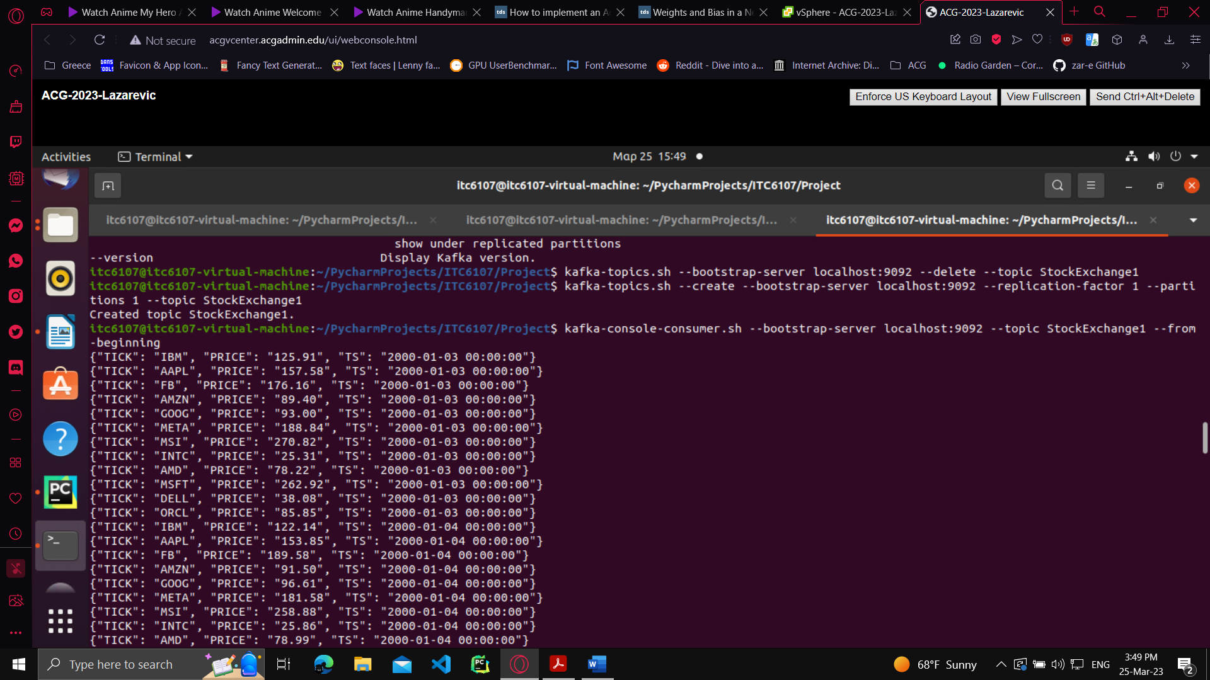
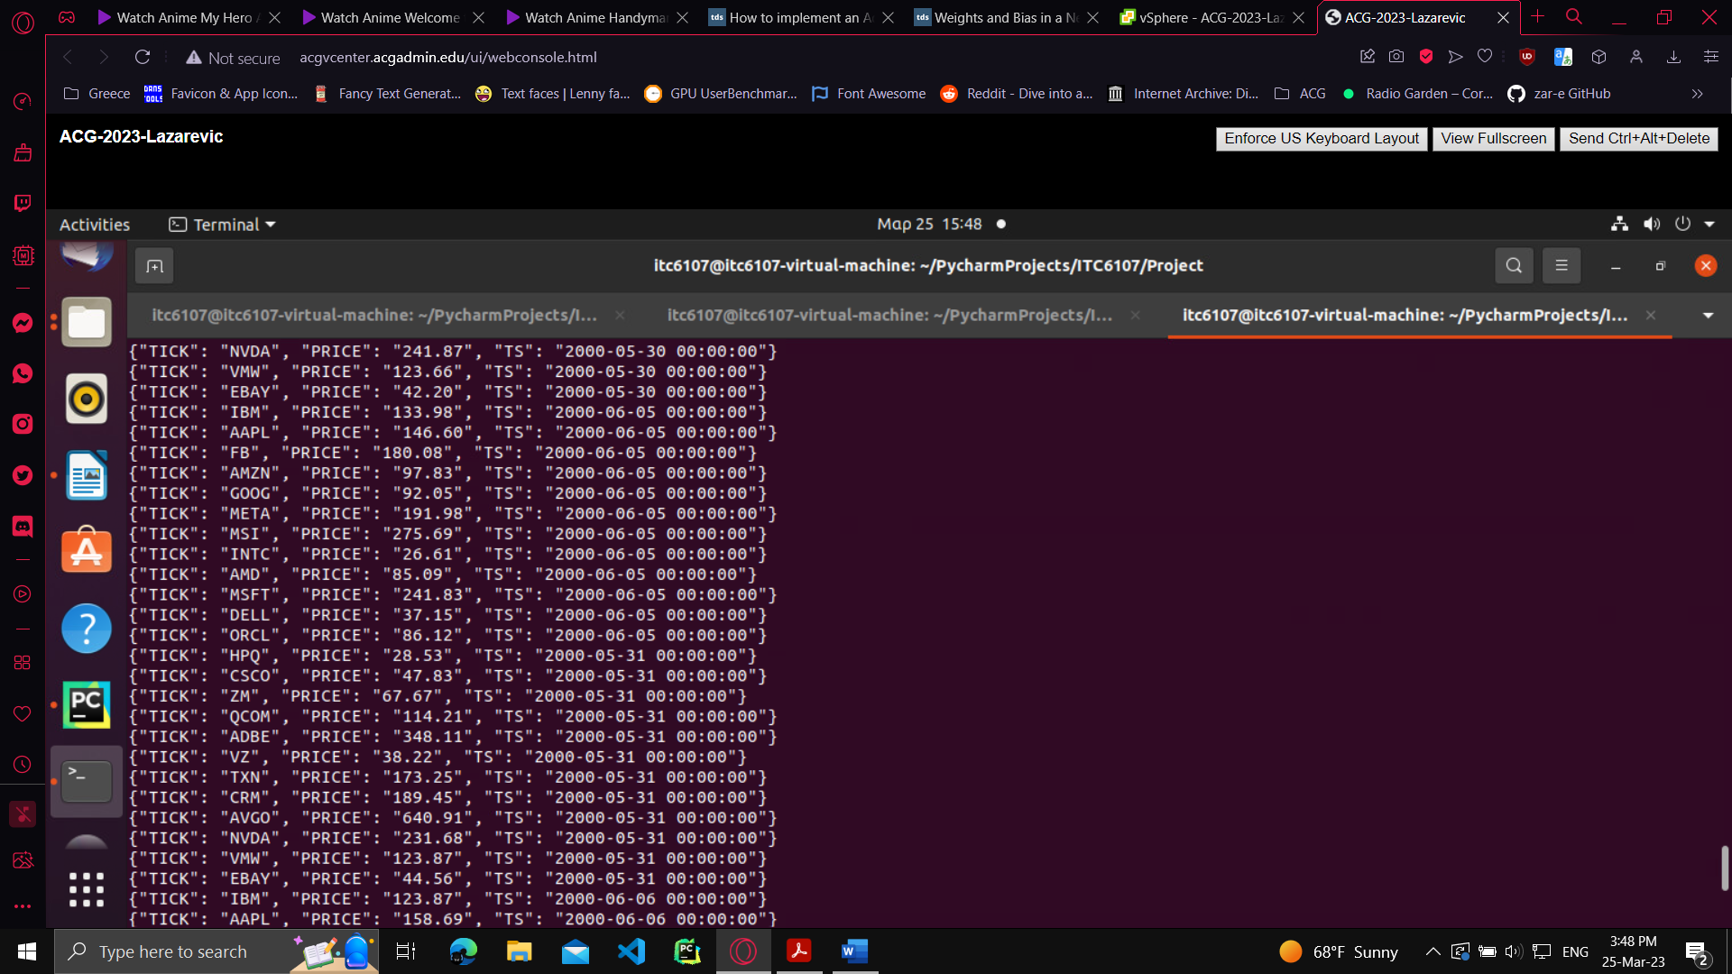
Kafka topic “StockExchange”
01/01: Saturday & Holiday
02/01: Sunday
se1_server.py
se2_server.py

Slide 5
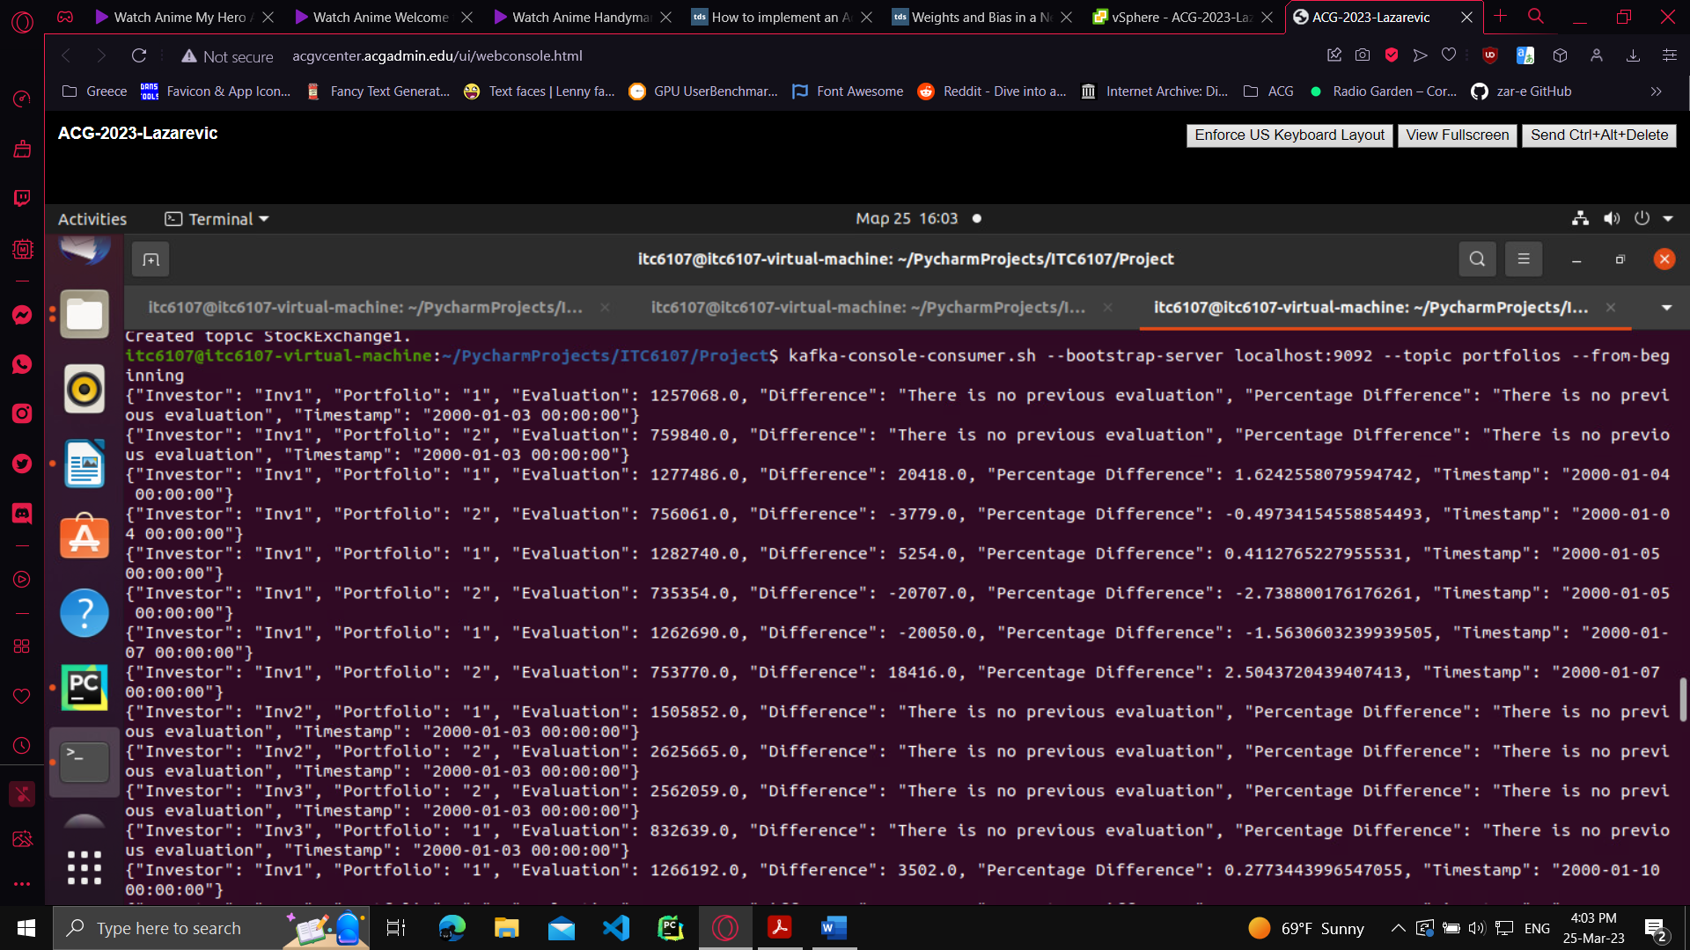
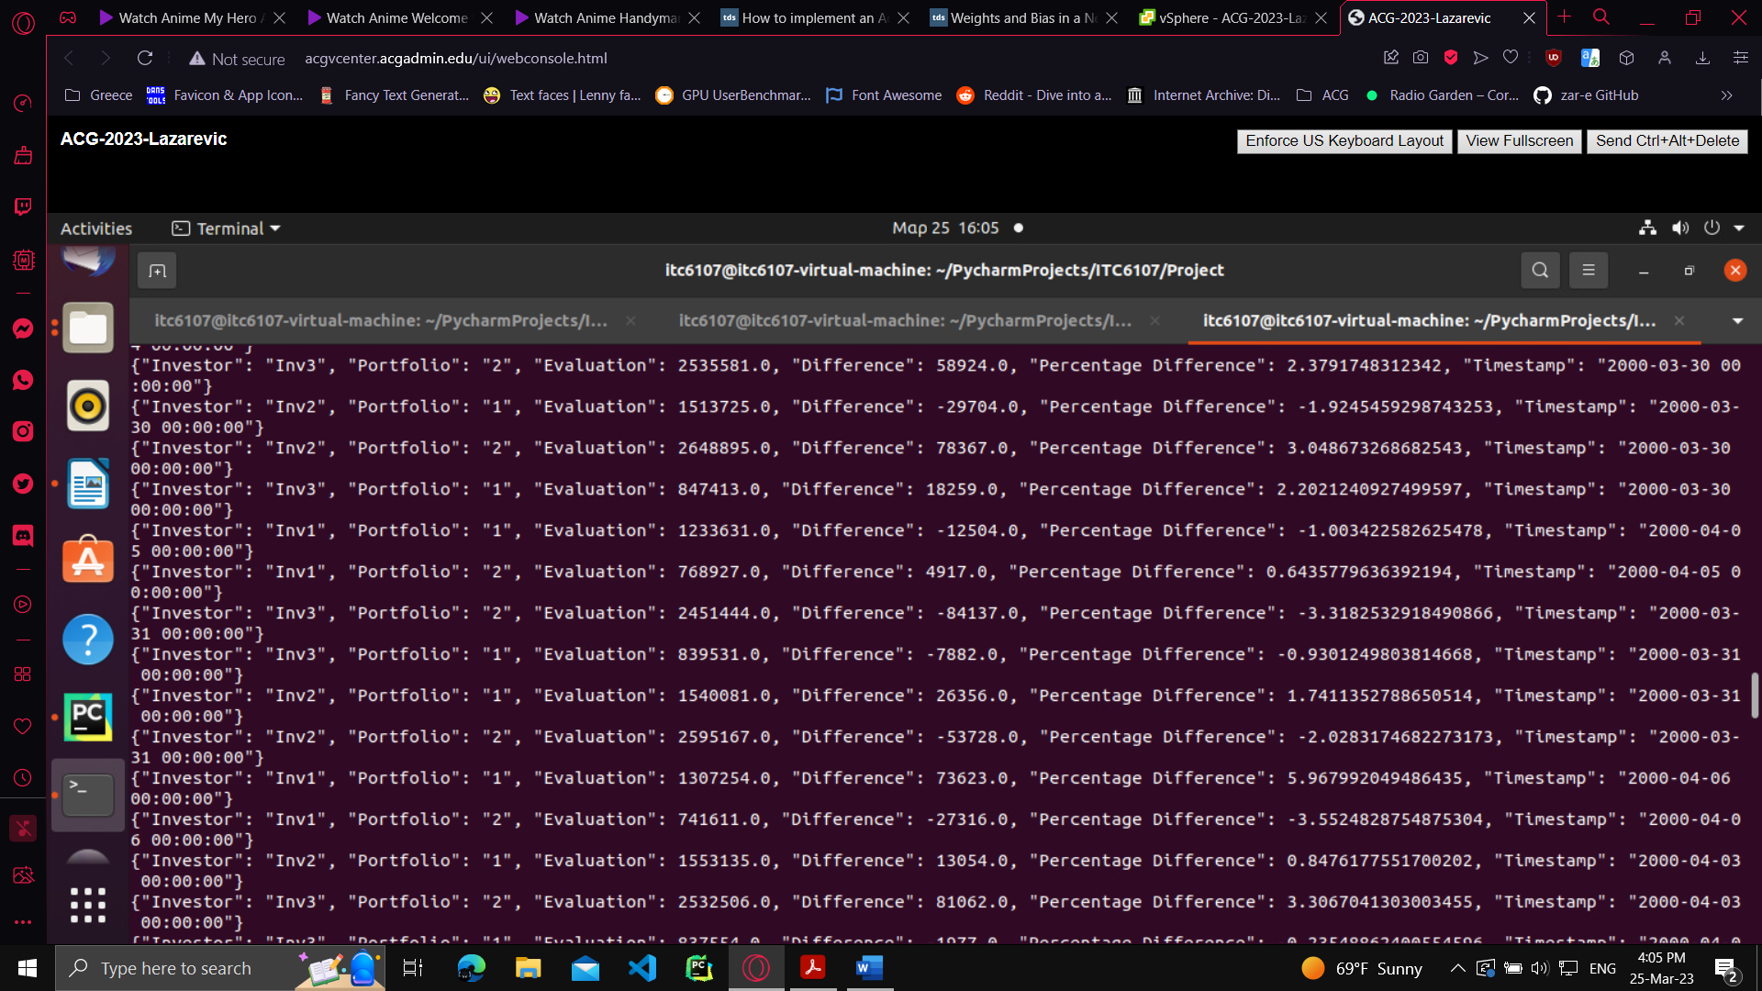
Kafka topic “partitions”
One partition
Three groups
Inv1 → g1
Inv2 → g2
Inv3 → g3
For each iteration:
Stock in Portfolio:
Evaluation: Add Price*Quantity
No. keys in dictionary = No. Stocks in the Portfolio →
Evaluation: Done

Slide 6
Applications
MySQL Database
App 1
01
Creates Needed Tables To Hold The Topic Data
Reads The “Portfolios” And Inserts Data Into The SQL DB
02
04
App 2
Investor_Portfolio
03
A Spark Application That Reads The SQL DB As SparkDF And Fetches The Required Data
The Result Of App 2, Values Are Output In A File Per Portfolio Of The Target Investor

Slide 7
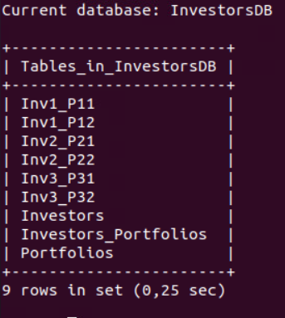
MySQL DB
Tables For Each Portfolio
Investor 1
Tables For Each Portfolio
Investor 2
Tables For Each Portfolio
Investor 3
Big Data Challenges
Fields With Investor ID, Name And City
Investors
Portfolios
Fields With Portfolio ID, Name And Mutual Funds (Cumulative)
Investors_Portfolios
Table Connecting Investors And Portfolios

Slide 8
Database Design
01
ID, Name, City (CHAR)
Investors
02
ID, Name, City, Cumulative (TINYINT)
Portfolios
InvestorsDB
03
PRIMARY KEY Iid, pid (FOREIGN KEY)
Inv_Port Conn
04
ID, DOUBLE, TIMESTAMP
<inv>_<port>

Slide 9
App 1
Connect
Read
Insert
Connects To The Kafka Topic “Portfolios”
(Kafka Consumer)
Reads The JSON Object Output From The Topic
(Loop Through)
Insert As Data Into InvestorsDB
(cursor.execute)

Slide 10
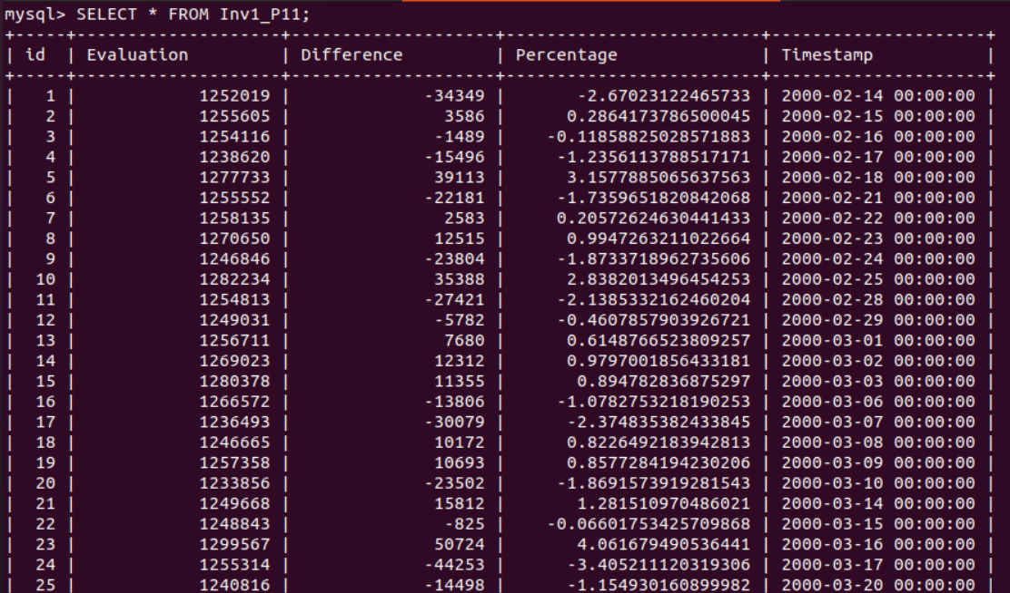
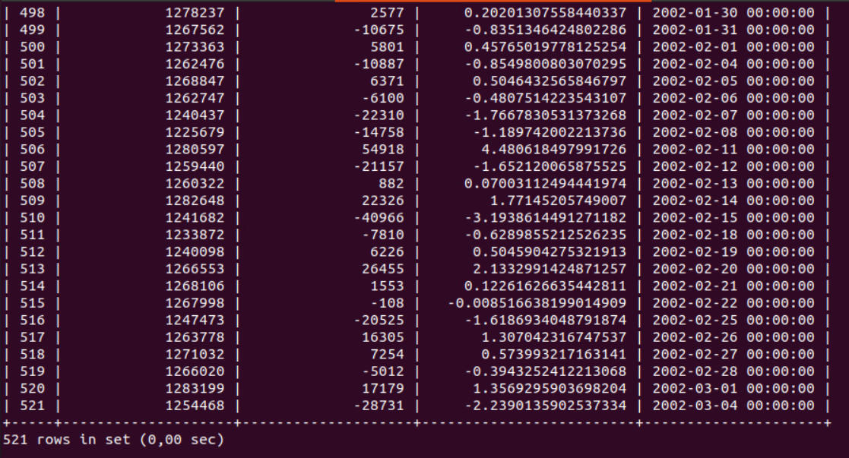
App 1 Results
Querying the tables
Data is inserted into the tables as it is generated, in order

Slide 11
App 2 Design
SparkSession
Spark Functions
Connects to the DataBase using mysql connector
Used in aggregation
Gets the needed values
CheckChoices(inv, port)
StartApp(1)
Variables
Despite being red, Mars is a cold place
Saves the collected data into variable
SparkDF
Write To File
2 Data Frames
Reads JDBC format
Uses CheckChoices()
Writes the stats of each portfolio to file

Slide 12
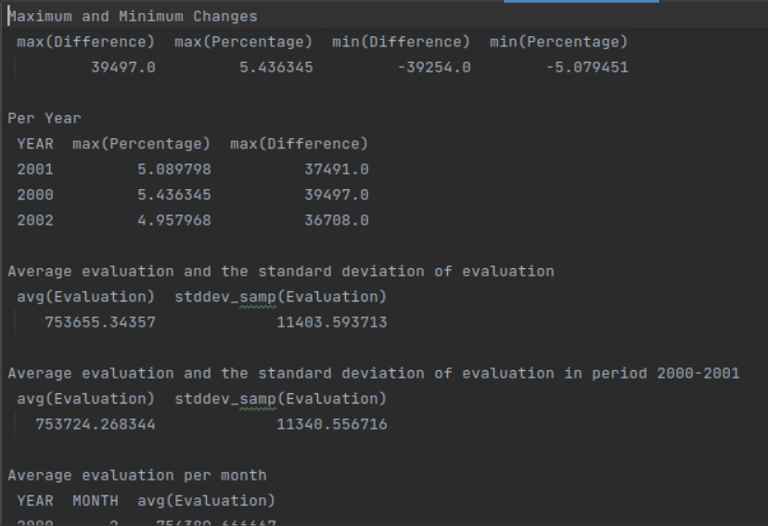
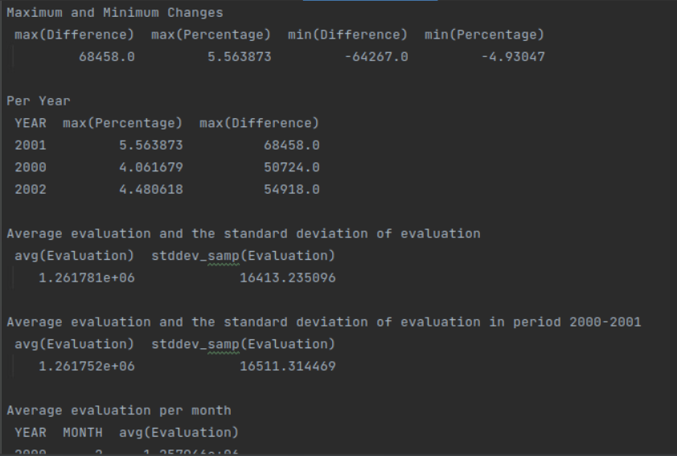
App 2 Output
“Inv1_1_stats”
Investor 1, Portfolio 1
“Inv1_2_stats”
Investor 1, Portfolio 2

Slide 13
THANK YOU

